Slide 1
Blackjack
Andy Cheong
Aparna Gangwar
Mohak Garg
Niranjan Akolkar
Notes:
Andy

Slide 2



Project Management
Version Control
Git
Source Control
GitHub
Code Review
Pull Requests
Peer Review
Communication
WhatsApp
In person
Meetings
Language
Java
Apis
Graphics
Objects
Swing
Notes:
Andy

Slide 3
Goal of the game
Get a hand value of 21 or less
Hand has to be greater than the dealer’s hand

Slide 4
Game rules
General:
Aces may be counted as 1 or 11.
Number cards hold their value.
Face cards have a value of 10.
After the players have bet, the dealer will give two cards to each player and two cards to himself.
Dealer
After player has had his turn. If dealer hand equals player hand and value is less than 18. Dealer will draw a card..
If the dealer goes over 21 points, then any player who didn't already bust will win.
Player Choice:
Blackjack: Player is deal a hand of value 21 (Ace + 10 value card). Wins.
Stand: Player ends his turn
Hit: Player draws another card.
Bust: Player hand value exceed 21, loses
Double: Player doubles his bet.
Surrender: The player forfeits half his wager, keeping the other half. Game ends
Notes:
ANdy

Slide 5
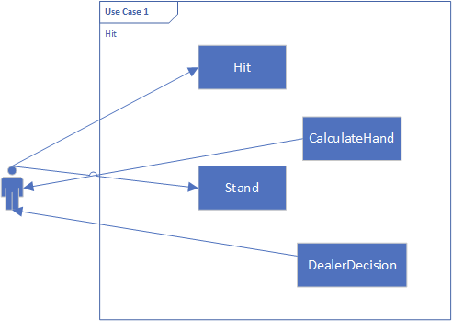
Use Case - Hit
Deal a new card to the hand
Notes:
Use cases : please go over the main use cases for your program. Discuss the actors, use cases themselves, and their associations/generalizations/aggregations/composition.
Andy

Slide 6
Demo
Notes:
Niranjan

Slide 7
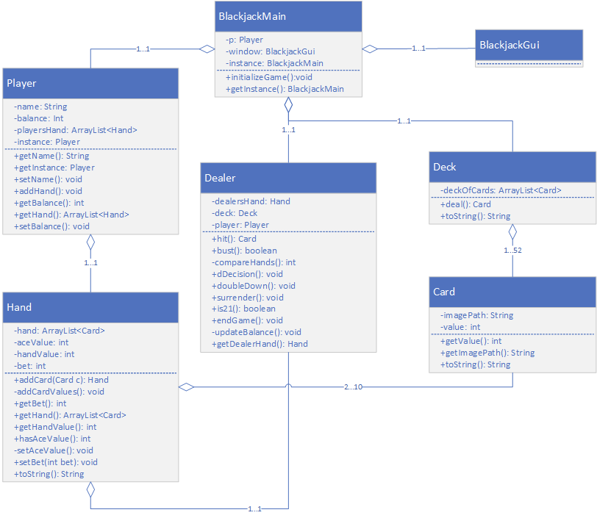
Back-End Class Diagram
Principles:
Separation of concerns
Stable intermediate forms
Relative Primitives
Encapsulation
Modularity
Hierarchy
Notes:
Class Diagram: use this time to discuss your rationale of design choices. For example, what are your classes/objects and why did you choose your design to be a particular way? What are your behaviors and states? what are the relationships between classes? how did you exploit the 4 principles of the Object Model?
Law of Demeter: each class has limited knowledge of other classes Law of Demeter
Aparna

Slide 8
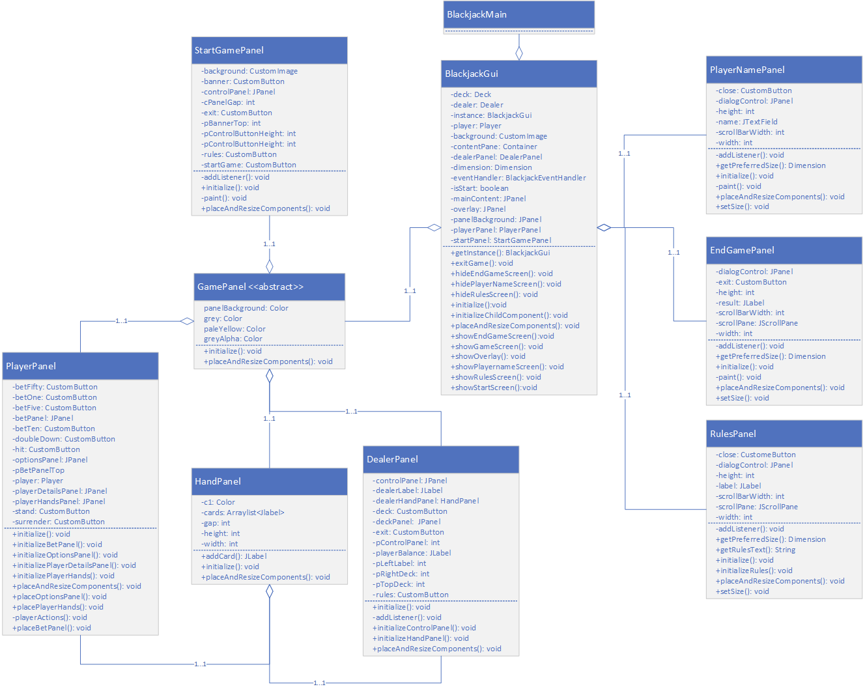
Front-End Class Diagram
Design Pattern: Singleton
Inheritance
Abstraction
Notes:
Class Diagram: use this time to discuss your rationale of design choices. For example, what are your classes/objects and why did you choose your design to be a particular way? What are your behaviors and states? what are the relationships between classes? how did you exploit the 4 principles of the Object Model?
Aparna

Slide 9
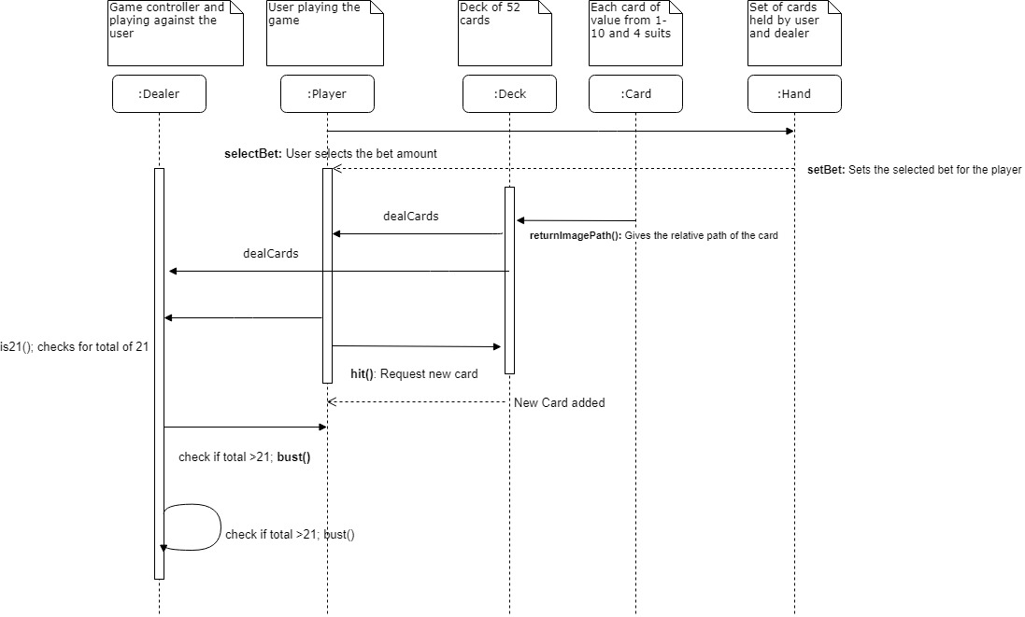
Sequence Diagram
Notes:
Sequence Diagram - show at least 1
Mohak

Slide 10
Traceability Matrix
2 Blackjack
Requirements | Description | Complete | Test
2.1 Blackjack win | Check if player won at beginning of game | Yes | testIs21()
2.2 Blackjack bet | Player wins 50% more of the bet | Yes | testBalance()
Notes:
Discuss how you managed traceability between your source code and your analysis / requirements
Mohak

Slide 11
Traceability Matrix
6 Surrender
Requirements | Description | Complete | Test
6.1 Lose bet | Player loses 50% of their bet | Yes | testIsSurrender()
6.2 At beginning of game | Option is disabled after Hit | Yes | testIsDisabled()
6.3 End game | Player loses game | Yes | testEndGame()

Slide 12
Test
Unit test cases were written to test the functionality of the classes present in the backend side of the code.
All the functionalities present in the dealer class which is the driver of the game were written in a separate Test.java file.
Tester functions with breakpoints were written to check all the corner cases present in the game.
Notes:
Discuss how you tested your program
Mohak

Slide 13
Software Design Document
Introduction
Software Requirements
Functional Requirements
Non-Functional Requirements
System Architecture
Class Diagrams
Use Cases
Glossary of Terms
Component Design
Backend Classes
Frontend Classes
Requirements Matrix
Notes:
Please provide a cursory run/review of your documentation
Mohak

Slide 14
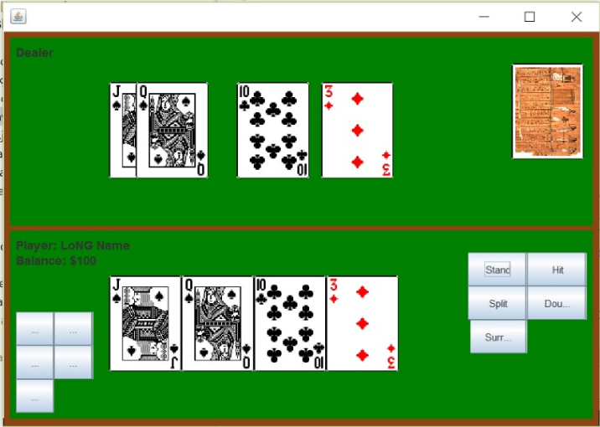
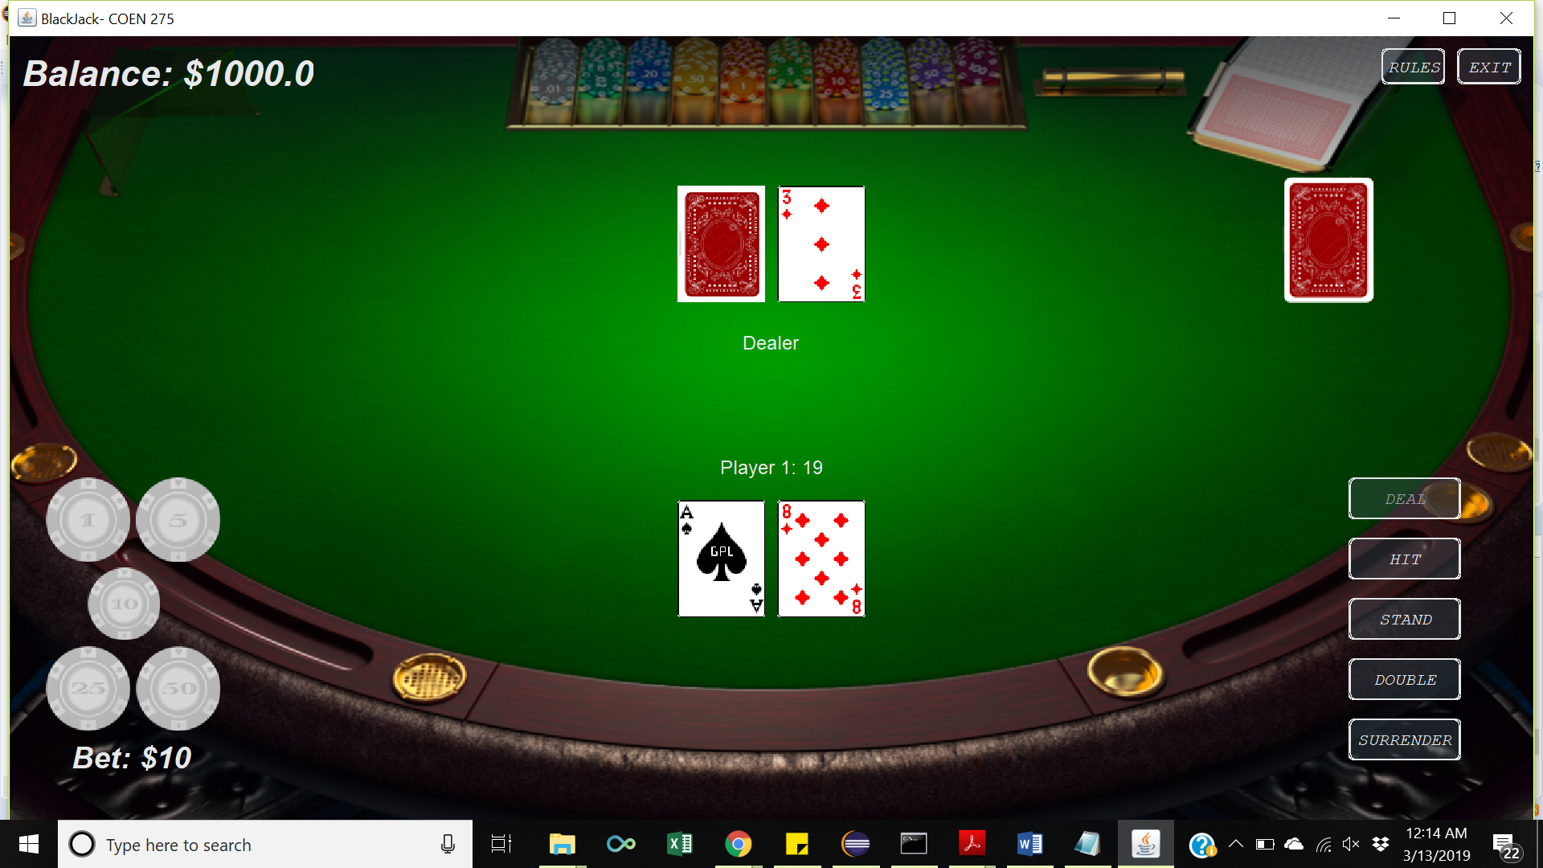
Lessons Learned
Understanding requirements before design and implementation.
Communication and collaboration
Dealing with increasing complexity
Importance of OOA, D, and P
Avoiding antipatterns
5 C’s
Booch’s principles
Notes:
Lessons Learned as it relates to our class discussions for OOA, D and P
Niranjan

Slide 15
Questions

